Slide 1
Proofs About Numbers
Creative Commons Attribution-NonCommercial-ShareAlike 3.0 Unported License. http://creativecommons.org/licenses/by-nc-sa/3.0/
Written by Rachel J. Morris, last updated 2016-09-17

Slide 2
Mathematical Writing
This Chapter:
Divisibility
Rational numbers
Modulus
More proofs

Slide 3
Definitions
Definition 1:
An integer n is divisible by a nonzero integer k if there is an integer q such that n = kq.
Other ways of saying this is,
“k divides n”, “k is a factor of n”,
“n is a multiple of k”.

Slide 4
Definitions
Definition 2:
A real number r is rational (aka a fraction) if there exists integers a and b (b is not 0)
with r = a/b.

Slide 5
Definitions
Definition 3:
A real number is irrational if it is not rational.

Slide 6
Definitions
The Division Theorem (page 103)
For all integers a and b (b > 0), there is an integer q (called “the quotient when a is divided by b”) and an integer r (called “the remainder when a is divided by b”) such that:
1.
2.

Slide 7
Definitions
Definition 4:
Modulus (aka “mod”, “%” in some computer languages) is used to describe the remainder when one integer is divided by another.
Thus: a mod b = r
Means that r is the remainder when a is divided by b.

Slide 8
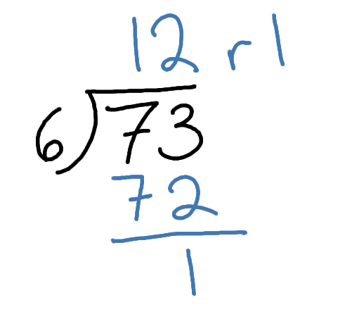
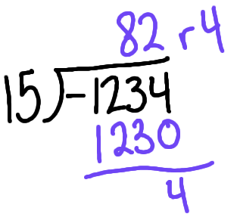
Calculating Modulus
2a. 73 mod 6 = 1
2c. -1,234 mod 15 = 4

Slide 9
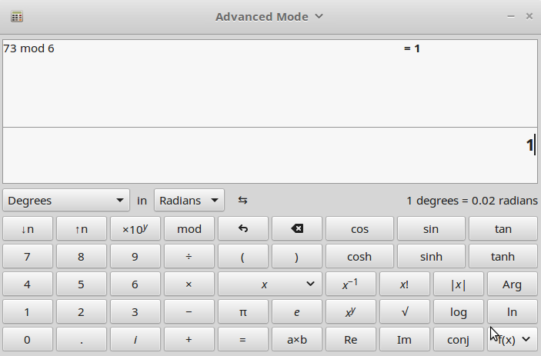
Calculating Modulus
2a. 73 mod 6
Most computer-based calculators also have the mod operator available.

Slide 10
Proofs
7a. Prove that:
“If a divides b and a divides c, then a divides b + c”
We need to express b and c as divisible by a, so we will restate them as:
b = Ka , c = La
1. Restate b+c with K,L terms:
2. Factor out the common a:
3. Now we can see that
K+L is still a factor of a.

